Slide 1
NTU Canteen Management System

Slide 2
Team Members
Kesarimangalam Srinivasan Abhinaya
Lee Lucius
Kong Cheng Zhen

Slide 3
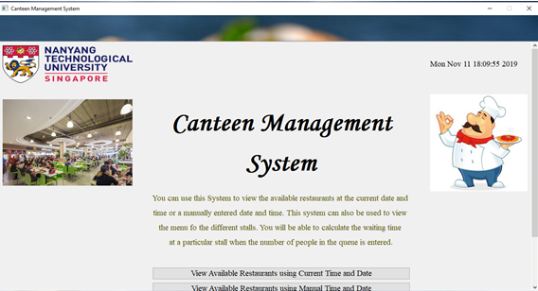

Slide 4
Estimated waiting time
Operating hours of stalls
All input validation functions

Slide 5
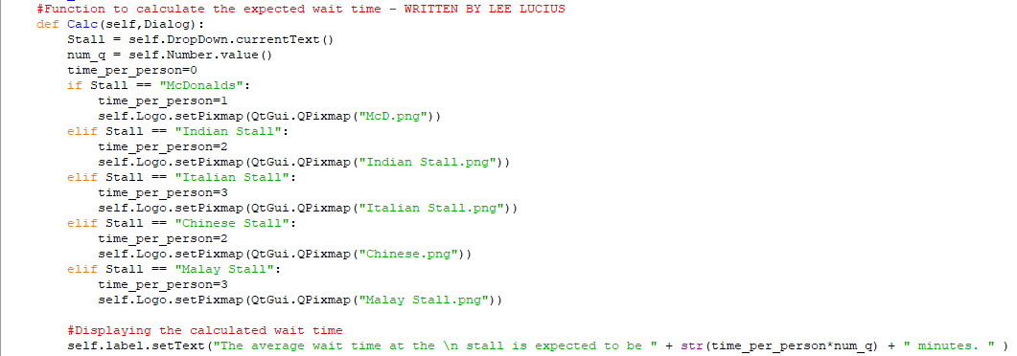

Slide 6
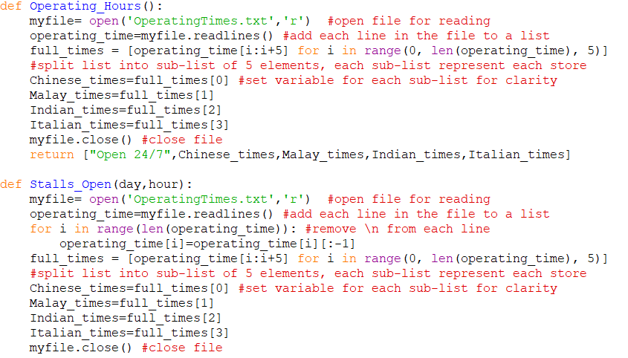

Slide 7
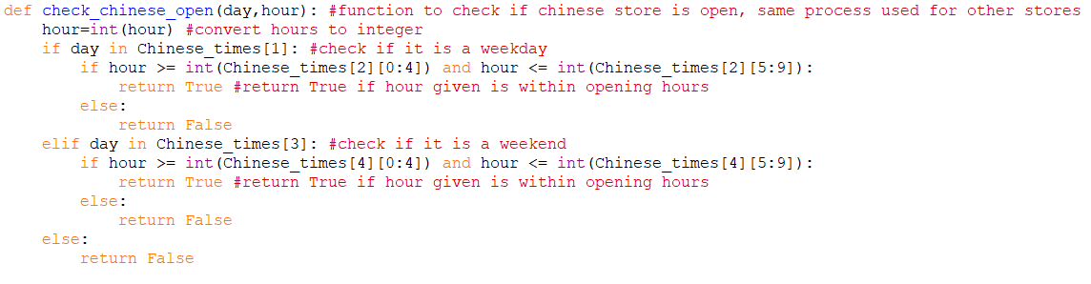

Slide 8
4. Current time menu
5. Manual date and time menu and stall availability

Slide 9
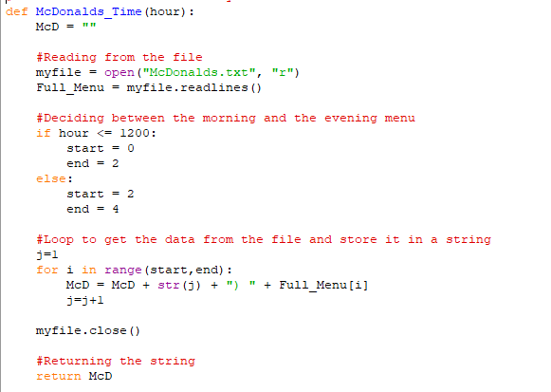

Slide 10
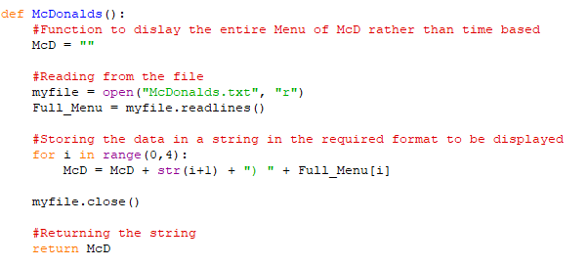

Slide 11
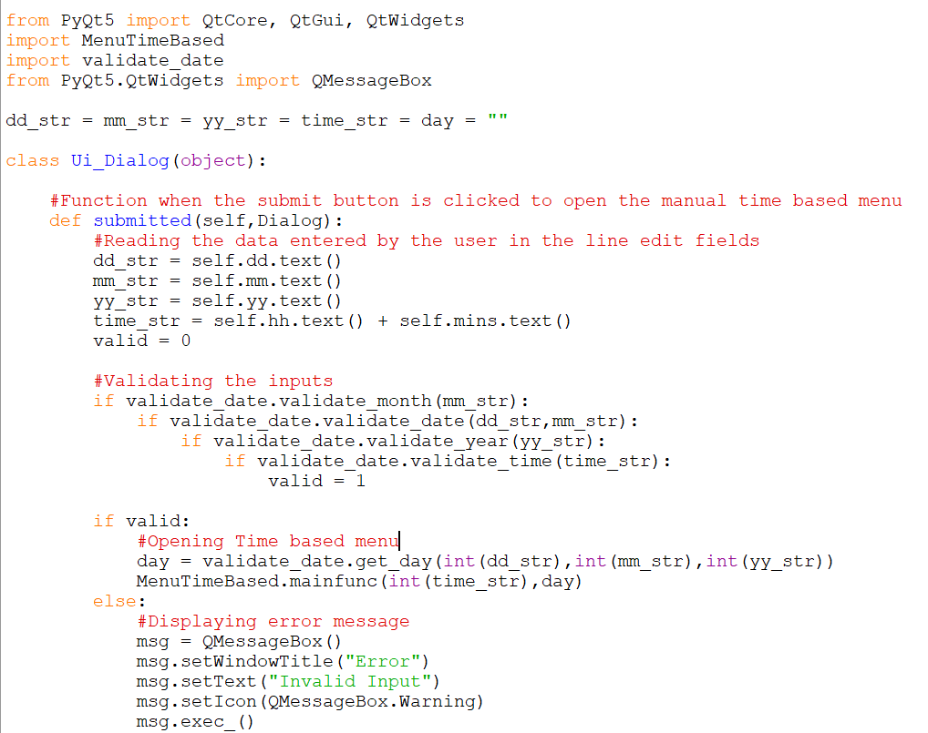

Slide 12
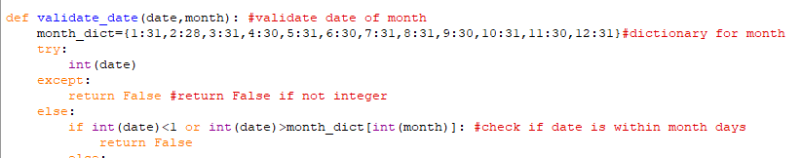

Slide 13
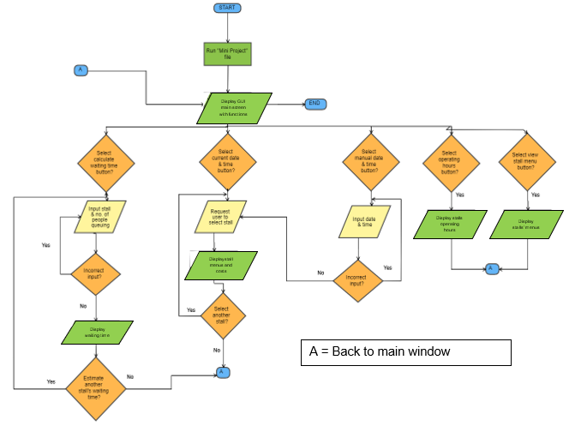
Yes
Yes
Yes

Slide 14
Creating the GUI

Slide 15
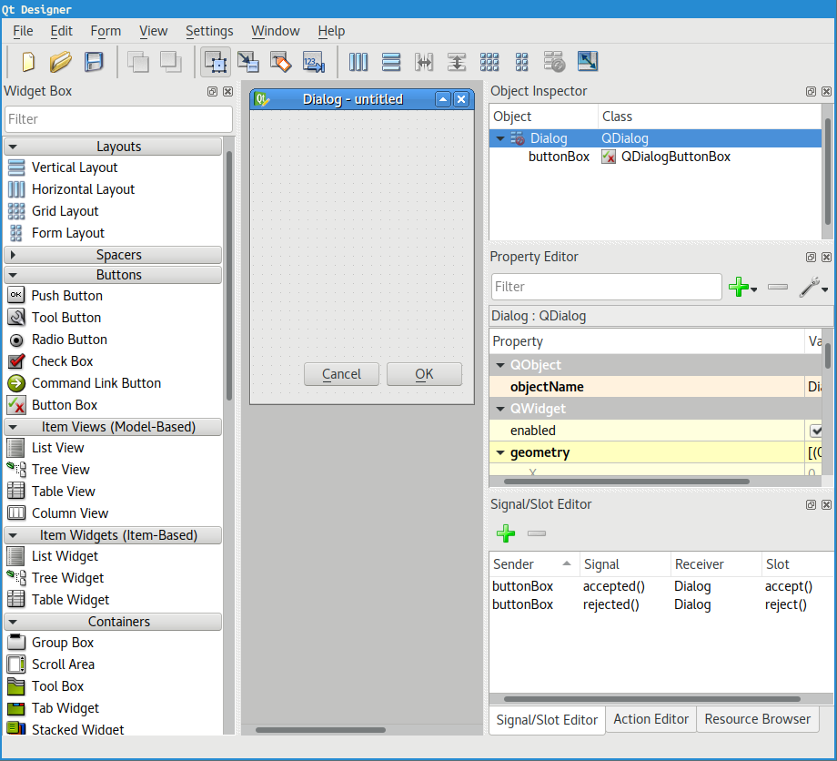

Slide 16

Important Steps
Create font
Create Window
Adding a background
Add a scroll area
Add the various widgets

Slide 17
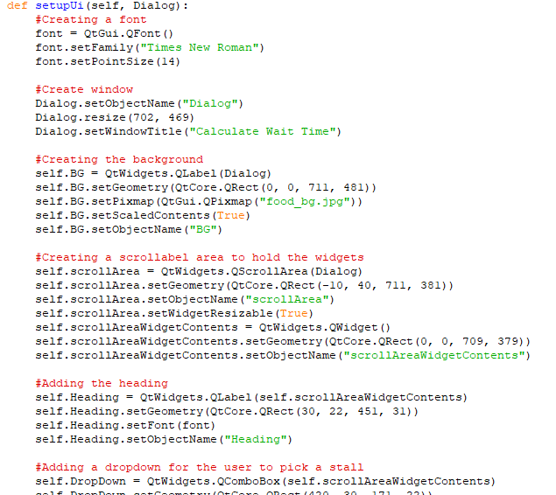

Slide 18
Different Widgets used
QComboBox - To create a dropdown
QLabel - To display images and text
QSpinBox - To get an integer input from the user
QPushButton - To create buttons
QScrollArea - To create an container that is scrollable in the widow

Slide 19
Thank You

